Slide 1

YouTube was created on the fifth of March by Steve Chen, Chad Herdley and David Karim

Slide 2
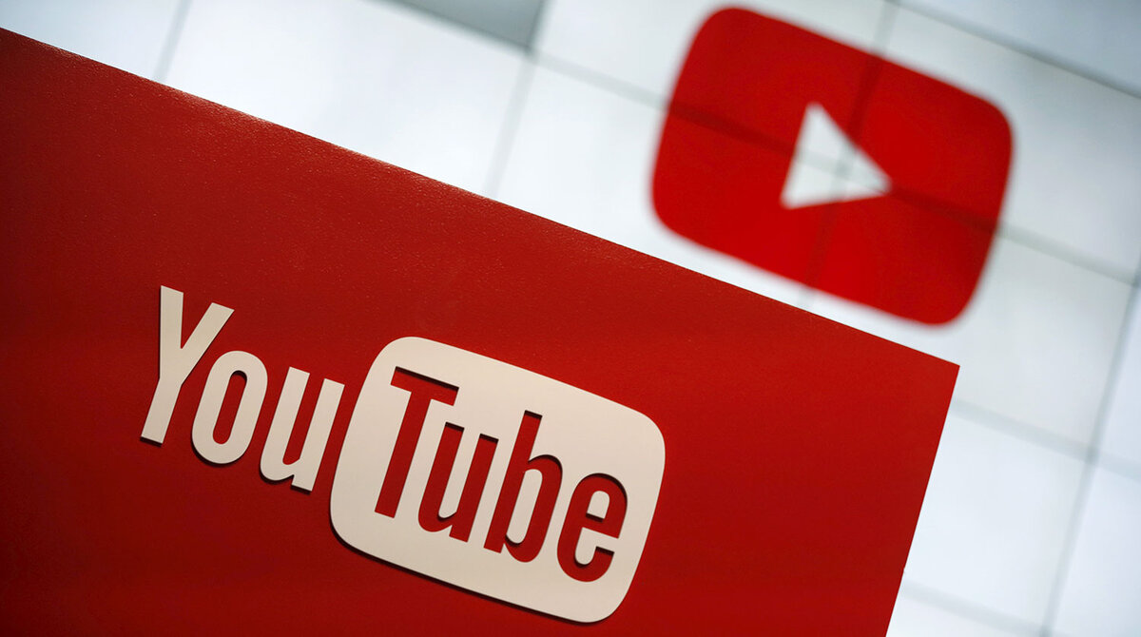
5 interesting facts about YouTube

Slide 3
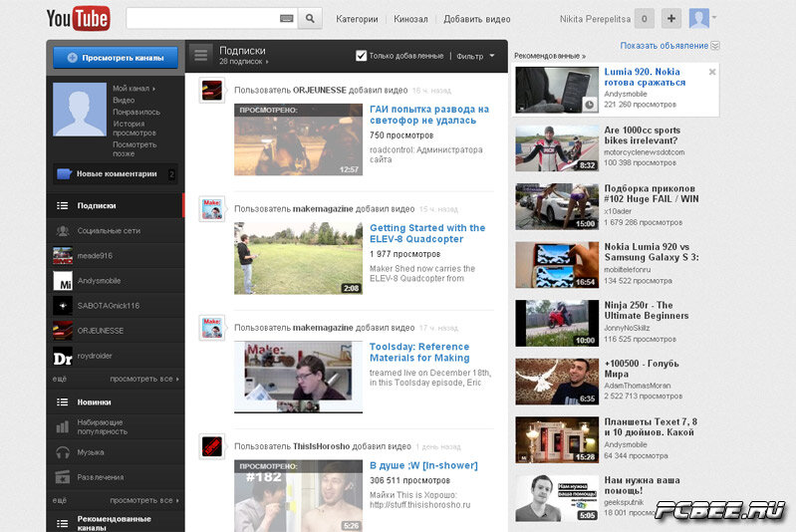
1. YouTube was planned as a dating site.

Slide 4
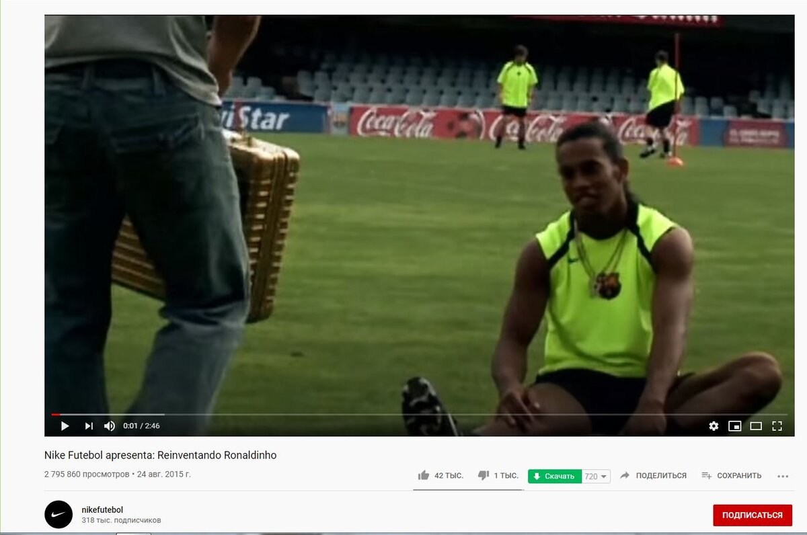

2. The very first video, which garnered 1 million views, was a video from the Nike campaign.

Slide 5
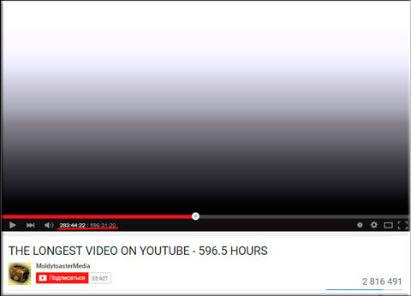

3. The longest video on YouTube lasts 24 days.

Slide 6
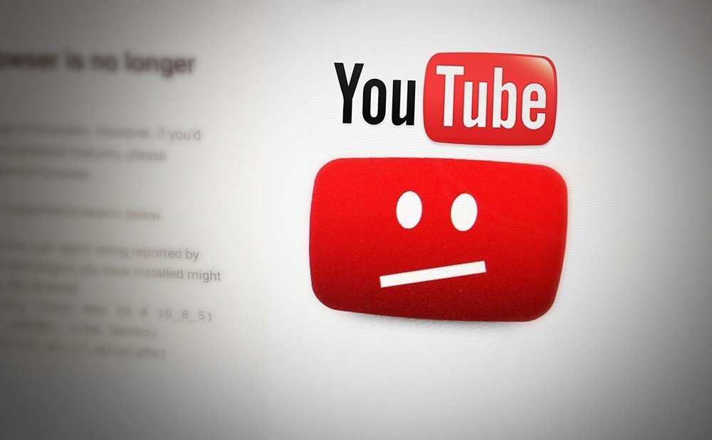
4. In China, YouTube has been blocked since two thousand and ninth year due to the conflict between the Chinese authorities and YouTube.

Slide 7

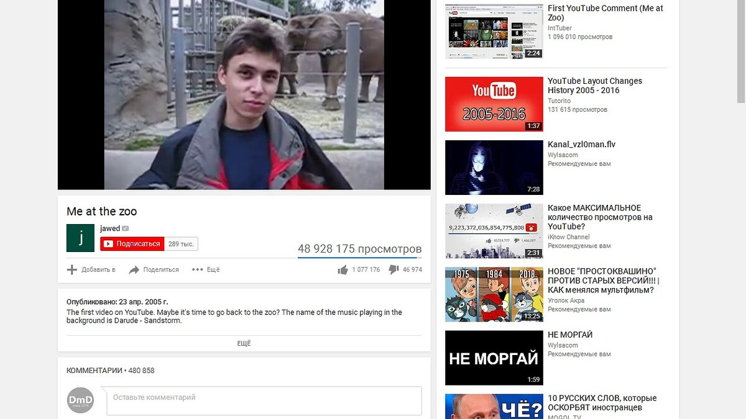
5. 300 hours of videos are uploaded to YouTube every minute

Slide 8

Thanks for your attention

